Slide 1
ONLINE PROFESSIONAL SOURCES
dr. Kármen KOVÁCS
Associate Professor
kovacs.karmen@ktk.pte.hu

Slide 2
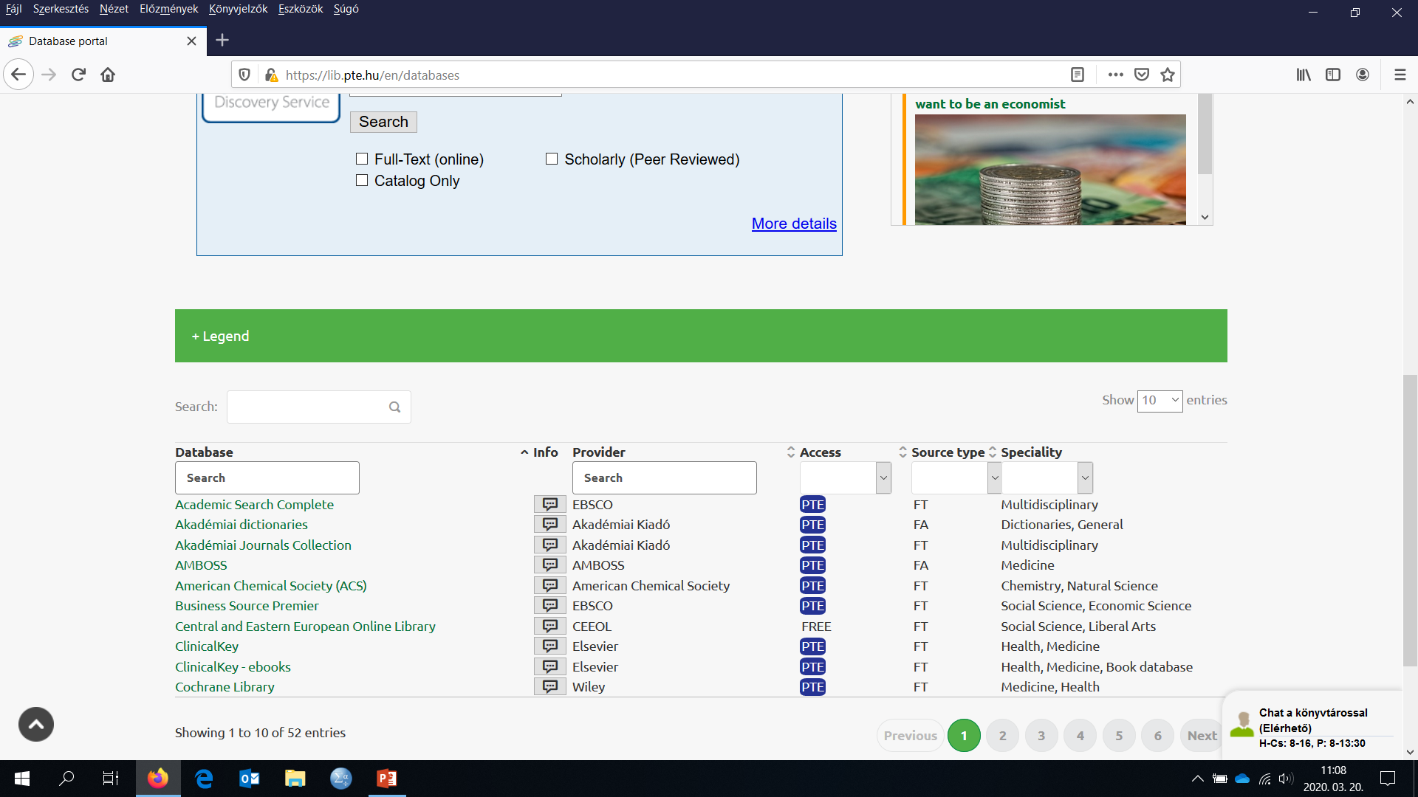
Connecting to the University Network
In order to access the subscribed professional sources, you need to connect to the university network
Guide to connect to the university network (remote access) https://www.lib.pte.hu/en/service/remote_access-222
By connecting to the university network, the e-journal and e-book databases are available https://lib.pte.hu/en/databases

Slide 3
Online International E-Journal and E-Book Databases

Slide 4
Online International Databases
The following database is available only by connecting to the university network via the website of the University Library
(see 2nd slide)
Business Source Premier (EBSCOhost)
Providing more thousands academic journals with full text articles
Journals to each subfield of business and economics
Both early and current volumes are available
Company data & information, documents (e.g. SWOT analysis) about companies
User-friendly searching system
Daily updated
Primarily recommended to thesis and dissertation researching

Slide 5
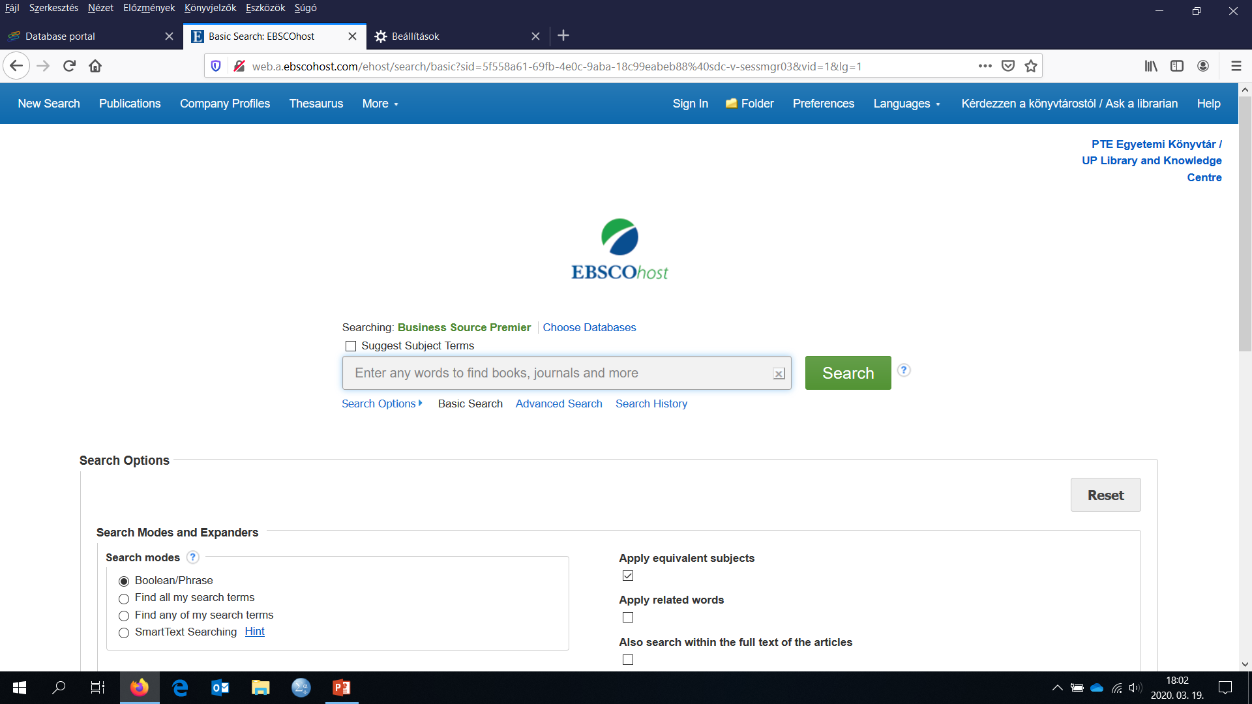
Online International Databases
Business Source Premier (EBSCOhost)
Browsing among journals
Description of effective searching tactics

Slide 6
Online International Databases
The following database is available only by connecting to the university network via the website of the University Library
(see 2nd slide)
EconLit with Full Text (EBSCOhost)
About 600 academic journals with full text articles
Both early and current volumes are available
User-friendly searching system
Daily updated
Academic Search Complete (EBSCOhost)
Multidisciplinary database
Useful to research related to other social sciences
More than 8,500 academic journals with full text articles

Slide 7
Online International Databases
The following database is available only by connecting to the university network via the website of the University Library
(see 2nd slide)
ScienceDirect (Elsevier)
Multidisciplinary database
Academic journals and professional books
Economic, financial, accounting, marketing, management and tourism journals
Both early and current volumes are available
Highly-ranked journals

Slide 8
Online International Databases
The following database is available only by connecting to the university network via the website of the University Library
(see 2nd slide)
JSTOR
Multidisciplinary database; academic journals, professional books
Retrospective database, that is, current volumes of the academic journals are not available but the earlier ones can be downloaded with full text
Primarily recommended to economic and financial research
Several economic journals are available with full text from 1880s
SpringerLink
Multidisciplinary database
Academic journals, professional books
Multilingual database

Slide 9
Online International Databases
The following database is available only by connecting to the university network via the website of the University Library
(see 2nd slide)
Wiley Online Library
Multidisciplinary database
About 1,500 academic journals with full text articles
ProQuest Central
Multidisciplinary database
Academic journals, professional books, dissertations
Statista
Statistics, forecasts
Data from more than 50 countries and 600 industries

Slide 10
Online International Databases
The subscribed databases have relatively little overlap in terms of content and the availability of academic journals, so it's worth searching in not only one but more databases

Slide 11
Online Business & Economic Working Paper Databases (open access with full text)
EBSLG working papers http://ebslgwp.hhs.se
Working papers of European Business Schools
EconPapers http://econpapers.repec.org/
The world’s largest online working paper database in the field of economics
About 2,800 working paper series
Chapters of e-books and conference papers are also available
S-WoPEc http://swopec.hhs.se
Economic Working Papers of Scandinavian Universities and Research Institutions
S-WoBA http://swoba.hhs.se
Business Working Papers of Scandinavian Universities and Research Institutions
SSRN http://www.ssrn.com/
Social Science Research Network is an international working paper database
RePEc http://repec.org/
Research Papers in Economics (RePEc)

Slide 12
Online Business & Economic Working Paper Databases via the Website of Universities
Harvard Business School Working Papers Collection http://www.hbs.edu/research/facpubs/workingpapers/
Cambridge Working Papers in Economics
http://www.econ.cam.ac.uk/research/impact-and-output/cambridge-working-papers
Economics Working Papers in Oxford
https://www.economics.ox.ac.uk/research/working-papers
Research Papers by Stanford Graduate School of Business Faculty
https://www.gsb.stanford.edu/faculty-research/working-papers
Warwick Economics Research Papers (TWERPS) http://www2.warwick.ac.uk/fac/soc/economics/research/workingpapers/
European University Institute Library, Working Papers Series in Economics
https://cadmus.eui.eu/handle/1814/2

Slide 13
Online Scientific and Professional Searching Systems
Google Books http://books.google.com/
Browsing among books and searching in the text of the books
Google Scholar http://scholar.google.hu/
Scientific searching system to e-journals, working papers and other e-documents
Central and Eastern European Online Library https://www.ceeol.com/
E-books and e-journals in social sciences
RFE (Resources for Economists on the Internet) http://rfe.org/
Website to economic data, research guides, porfessional organisations and e-documents

Slide 14
Website of Professional Organisations, Institutions and Companies
Professional organisations, institutions and companies publish several relevant
data,
information,
papers,
reports
E.g. OECD www.oecd.org, IMF www.imf.org, World Bank www.worldbank.org

Slide 15
Some Methods for Systematic Literature Survey
Based on library and online catalogues
using keywords and subjects
keyword combinations
sorting by relevance
Following literature
follow the „literature chain”
reviewing the References to find relevant sources
According to authors
„follow-up author method”
search for the publications of a certain author (scholar)

Slide 16
Sources Not Appropriate for Professional Research and Referencing

Slide 17
Not Allowed
Wikipedia
Hobby websites
Publications published by predatory publishers and predatory journals (see next slide)
Documents published by non-identified authors or authors with uncertain professional background…

Slide 18
Predatory Journals and Publishers
Business-driven but non-ethical businesses exploiting researchers have to publish
Selecting papers for publishing not professionally
The person who pays can publish a paper
Publication fees are not always announced in advance
Communicating not professionally (text of e-mails and websites)
„Call for papers” e-mails
There is no official list about them
’’informal blacklist” https://beallslist.net/
https://predatoryjournals.com/journals/
Not accepted by the academic sphere

Slide 19
Thank you for your kind attention

