Slide 1

Police Department of
Pécs
Important information on Police
by
Lt. Col. Mihály Pétermann,

Slide 2
Police Department of
Pécs
Task of police in Hungary:
-maintain public order
-investigate crimes
-guard the borders
-maintain traffic order
The University of Pécs belongs to the territorial competence of the Police Department of Pécs
Contact:
H-7622 Pécs, Vargha Damján Str. 3.
Phone: +36 72 504 400, Fax: +36 72 504 414,
E-mail: pecsrk@baranya.police.hu
Helpline: 112 (english/german spoken)

Slide 3


Police Department of
Pécs
Hungarian police uniform:

Slide 4
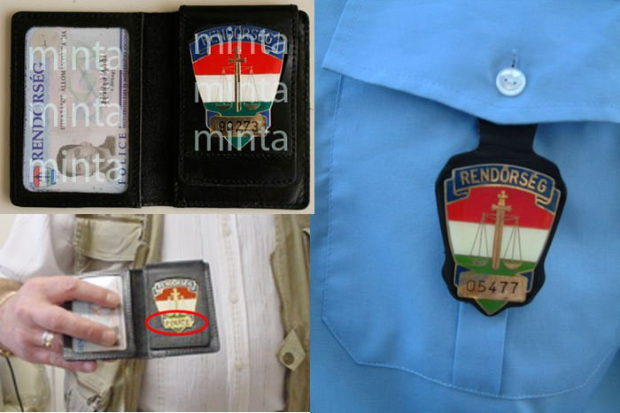
Police Department of
Pécs
Official identification card and badge

Slide 5
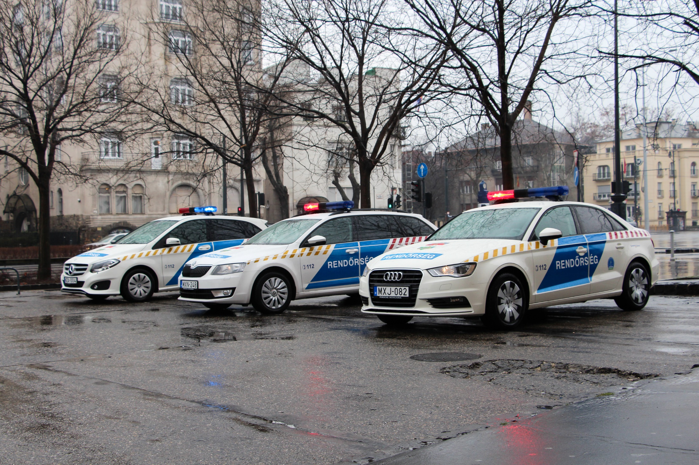
Police patrol cars

Slide 6
Police Department of
Pécs
Aim of ID check can be:
identify a person
determine the legality of staying in Hungary
Documents you must always show to the police officer:
EEA citizens: ID card or passport
non-EEA citizens: passport AND visa OR residence permit
(note: do not forget to renew your residence permit!)
You must be able to prove your legal stay in Hungary at any time!
Never argue, be cooperative!
Non-cooperative behaviour can cause that you will be taken to the police for further check.
Active or passive resistance is a crime or minor offence in Hungary.

Slide 7
Police Department of
Pécs
Complaint against police measures:
Personally at any Police Department, Police HQ or at the Central Complaints Office in Budapest (Teve Str. 4-6)
Via e-mail: panasz.orfk@orfk.police.hu or pecsrk@orfk.police.hu
Via Fax: +36 1 462 7499
Complaints will be handled in foreign languages as well

Slide 8
Police Department of
Pécs
If you became a victim of a crime or minor offence (theft, assault, …) please report it:
personally at the Police Department of Pécs 24/7
(Pécs, Vargha D. u. 3.)
via e-mail: pecsrk@baranya.police.hu
by post: H-7601 Pécs POB 249
by phone: 112 or 107 (hotlines panasz.orfk@orfk.police.hu panasz.orfk@orfk.police.hu)
Police provides the participation of an english-speaking officer or an interpreter

Slide 9
Police Department of
Pécs
Crime reports should contain:
-what, when, where happened
-who was involved
-injuries, damages
-data of stolen/damaged objects (e. g. price, IMEI)
-witnesses (name, phone, any data of them)
-your name, citizenship, address
-your phone number, e-mail address
If urgent: call 112/107 or contact the nearest police officer!!!

Slide 10
Police Department of
Pécs
If you drive a vehicle (incl. bycicle) you are not allowed to drink alcohol or take drugs.
Zero tolerance for drink and drive!!!
For driving a motored vehicle (scooter as well!!!) you have to have a driving licence. Foreign licenses from out of the EEA are valid for maximum one year after beginning your residence in Hungary. Fines start from 90k HUF (≈300 euro) and you can be banned from driving.
Wearing a helmet on scooter is obligatory! Passengers can't travel on scooters!
By bycicle ride at bycicle ways! Traffic signs show where it is prohibited to ride a bike.
At pedestrian crossings you have to get off the bike and cross the road by foot.
Wearing a helmet on bycicles is not obligatory but adviseable!

Slide 11


Police Department of
Pécs

Slide 12
Police Department of
Pécs
All forms of activities (buying, consuming, selling, possession) with drugs and new psychoactive materials are illegal in Hungary.
Police will start a criminal investigation in each case.

Slide 13
Police Department of
Pécs
Typical offences:
Truculence – happens mainly at bars, clubs. Mostly it means an agressive behaviour or assault after a verbal quarelling. Both sides could be punished!!!
Silence nuisance – happens mainly at private residences, during a party. It means a causeless noise-making at any time of the day (but of course mainly during the night).
For stopping an offence police officers can enter the private residence. Offenders can be fined by the officer him/herself or he/she can start an investigation. Refusing the stopping the offence can cause the offender to be taken to the police.
This can last up to 8+4 hours.

Slide 14
Police Department of
Pécs
Most typical offences committed against foreign students:
Theft by entering a housing: offenders get into the flat via the not locked door and steal valuables, money, laptops, phones, bags. Lock your door!!!
Theft by occasion – bags, clothes, phones other valuables left at public spaces like university, library, park, bars, clubs are stolen. Always pay attention to your valuables!!!
Theft of bycicles – bycicles left unlocked (sometimes even locked) are stolen at streets, staircases, courtyards. Lock your bycicle and don't leave it there for too long!!!

Slide 15
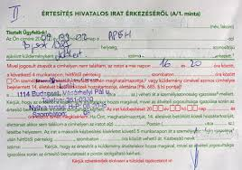
Police Department of
Pécs
Some other tips:
always notify immigration office when you change your address in Hungary
always take over your post
official letters are in hungarian
remember taxes and insurance
when buying a car
pay your fines (arrest warrant)
be careful with your money
block your credit card if stolen
-learn the most important words in hungarian
-public transport is not free of charge in Pécs

Slide 16
Police Department of
Pécs
Thank you for your attendance
Any question?
pecsrk@baranya.police.hu

